Slide 1
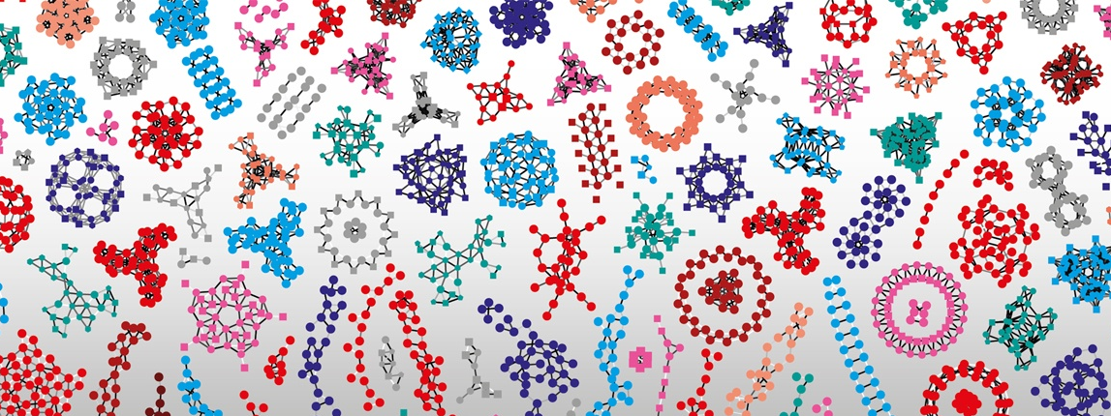

Introduction to RNA-Seq – Overview
Wandrille Duchemin
Notes:
<number>

Slide 2
First some logistic
Course page : https://edu.sib.swiss/course/view.php?id=475
Login : rnaseq19
Password : SIB-rnaseq19
Slides , schedule , feedback
Google doc : https://docs.google.com/document/d/1FPpd4fK7KhI9epzQzhUpk5Aj47kIPtIFn0f6s0rU6Nc/edit#
Questions during/after course

Slide 3
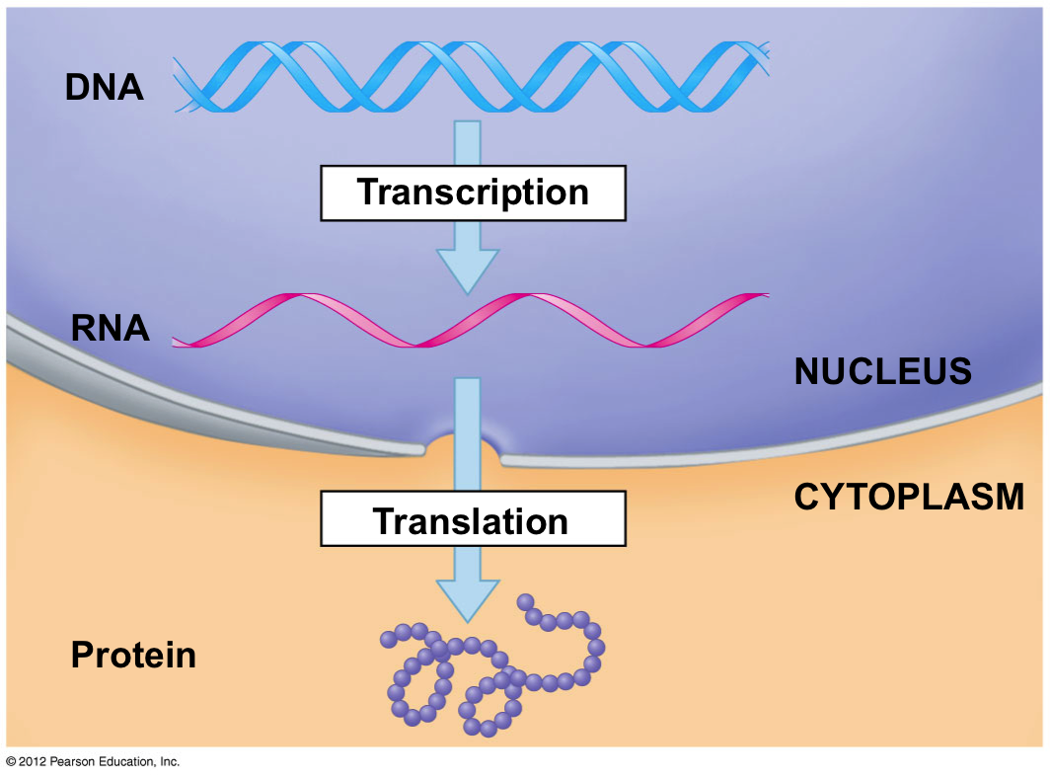
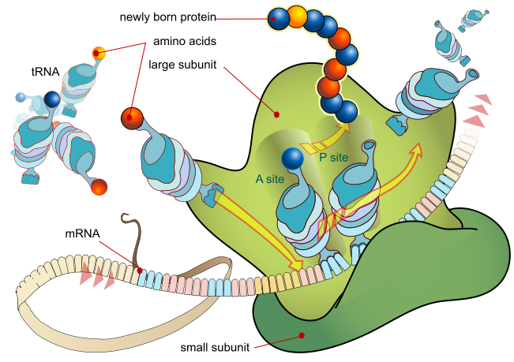
Nucleic acids everywhere
Notes:
<number>

Slide 4
Dogma Revisited
DNA
E
N
V
I
R
O
N
M
E
N
T
RNA
Protein
Small molecules
Development and Physiology

Slide 5
Dogma Revisited
DNA
RNA
Protein
Small molecules
Development and Physiology
https://en.wikipedia.org/wiki/Alternative_splicing#/media/File:DNA_alternative_splicing.gif

Slide 6
Dogma Revisited
DNA
~20,000 mammalian genes
RNA
Protein
>>100,000 (?) transcripts
>>>1,000,000 (??) proteins
Small molecules
Cellular Diversity
Development and Physiology
https://en.wikipedia.org/wiki/Alternative_splicing#/media/File:DNA_alternative_splicing.gif

Slide 7
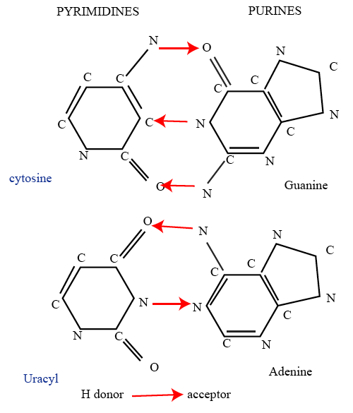
Nucleobases – building blocks of nucleic acids
Image source : wikipedia.org

Slide 8

What (and why) are we sequencing?
Genomics
Whole genome/exome sequencing (WGS, WES)
Single nucleotide polymorphisms
Copy number variations
Structural variations
DNaseI hypersensitivity analysis
Chromatin structure, binding of transcription factors
Hi-C (High throughput Chromomosome Conformation Capture)
Chromatin structure (looping)
Epigenomics
Bisulphite sequencing (DNA methylation)
ChIP-seq, ATAC-Seq
Notes:
<number>

Slide 9
What (and why) are we sequencing?
Transcriptomics
Total RNA sequencing
PolyA+ RNA sequencing
Ribozero
Genome annotation
Allele-specific expression
Transcript identification (lncRNAs)
Alternative splicing
Gene Fusion
5`/3` tag sequencing
Gene expression analysis
Small RNA sequencing
Identification and expression analysis of small RNAs (eg miRNAs)
Metabolic labeling – RNA Seq
Analysis of mRNA decay
Crosslinking and immunoprecipitation of RNA-binding proteins (CLIP)
Binding sites of RBPs
Ribosome footprinting
Analysis of mRNA translation
Ribometh-seq and similar
Detection of RNA modifications
Single-cell transcriptomics
Imagination is the limit!

Slide 10
What (and why) are we sequencing?
Transcriptomics
Total RNA sequencing
PolyA+ RNA sequencing
Ribozero
Genome annotation
Allele-specific expression
Transcript identification (lncRNAs)
Alternative splicing
Gene Fusion
5`/3` tag sequencing
Gene expression analysis
Small RNA sequencing
Identification and expression analysis of small RNAs (eg miRNAs)
Metabolic labeling – RNA Seq
Analysis of mRNA decay
Crosslinking and immunoprecipitation of RNA-binding proteins (CLIP)
Binding sites of RBPs
Ribosome footprinting
Analysis of mRNA translation
Ribometh-seq and similar
Detection of RNA modifications
Single-cell transcriptomics
Imagination is the limit!
A longer but non exhaustive list :
https://liorpachter.wordpress.com/seq/

Slide 11

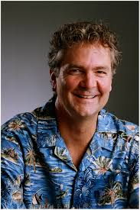

Beginning of sequencing: Sanger’s method
Could be applied to wide range of fragment lengths, used initially in whole genome sequencing
Extract, purify and fragment genomic DNA
Make clone library
Sequence clone
Assemble the genome
Fill gaps
Computationally intensive for alignment and assembly
Gene Myers
Frederick Sanger
David Haussler

Slide 12
Sanger sequencing method
Uses chain terminating nucleotides which are stochastically incorporated
Gel electrophoresis allows one to ’read’ the sequence
A
C
G
T
AGTAGTGTGTGCCCGTCTGTTCGTATCTTCTTGCGCTTCA
AGTAGTGTGTGCCCGTCTGTTCGTATCTTCTTGCGCTTC
AGTAGTGTGTGCCCGTCTGTTCGTATCTTCTTGCGCTT
AGTAGTGTGTGCCCGTCTGTTCGTATCTTCTTGCGCT
AGTAGTGTGTGCCCGTCTGTTCGTATCTTCTTGCGC
AGTAGTGTGTGCCCGTCTGTTCGTATCTTCTTGCG
AGTAGTGTGTGCCCGTCTGTTCGTATCTTCTTGC
AGTAGTGTGTGCCCGTCTGTTCGTATCTTCTTG
AGTAGTGTGTGCCCGTCTGTTCGTATCTTCTT
AGTAGTGTGTGCCCGTCTGTTCGTATCTTCT
AGTAGTGTGTGCCCGTCTGTTCGTATCTTC
AGTAGTGTGTGCCCGTCTGTTCGTATCTT
AGTAGTGTGTGCCCGTCTGTTCGTATCT
AGTAGTGTGTGCCCGTCTGTTCGTATC
3’
5’

Slide 13
Underlying principle
Sequencing by synthesis
Sanger/Dideoxy chain termination – 1st generation
Pyrosequencing (Roche/454) – 2nd generation
Reversible terminator (Illumina) – 2nd generation
Ion torrent (Life Technologies) - 3rd generation
Zero Mode Waveguide (Pacific Biosciences) - 3rd generation
Sequencing by Oligo Ligation Detection
SOLiD (Applied Biosystems) – 2nd generation
Direct reading of DNA/RNA sequence
Nanopore sequencing – 3rd generation
Notes:
<number>

Slide 14
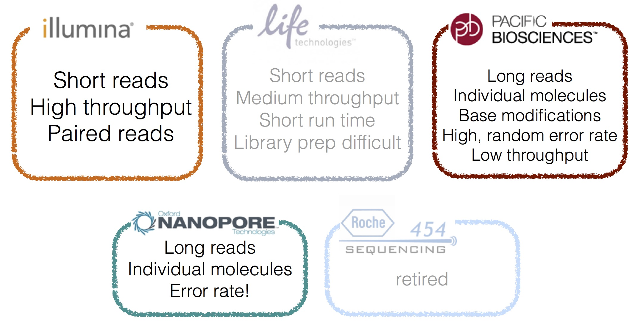
Major technologies
SOLiD

Slide 15
Read lengths
assembled
single molecule

Slide 16
Challenges for RNA-Seq
RNA is highly labile and exposed to degradation enzymes
Hydroxyl group of ribose - reactive, uracil - less stable than thymine, RNAses
How to preserve RNA integrity?
RNA molecules are highly diverse
High dynamic range of expression, from hundreds of thousands per cell (rRNAs, small RNAs) to very few (mRNAs)
Large differences in lengths, from tens to millions of nucleotides
How to capture the species of interest?
How to preserve strand information?
How to preserve relative abundances?
How to normalize inferred abundance to compare between samples?
Sequencing reads need to be mapped
To genome or to transcriptome?
Which reference to use?
How to handle reads that come from exon-exon boundaries?
How to handle multi-mapping sequencing reads?

Slide 17
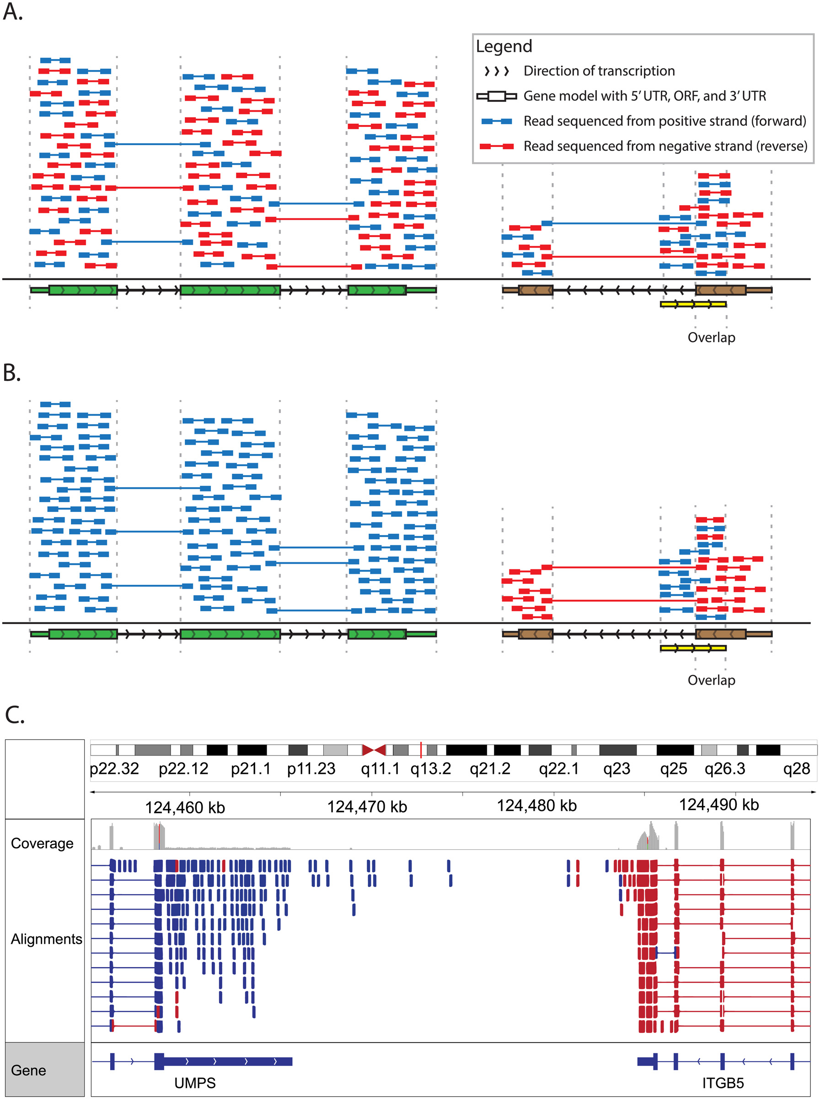
Stranded vs Unstranded Sequencing
A substantial proportion of the genome is transcribed in both directions (~8% in Homo sapiens)
Use a protocol that preserves the strand information to make it easier to quantify the expression from overlapping loci on opposite strands
Achieved by ligating different adaptors to the 5’ and 3’ ends before cDNA synthesis
M.Griffith et al PLoS Comp Biol 2015
Notes:
<number>

Slide 18
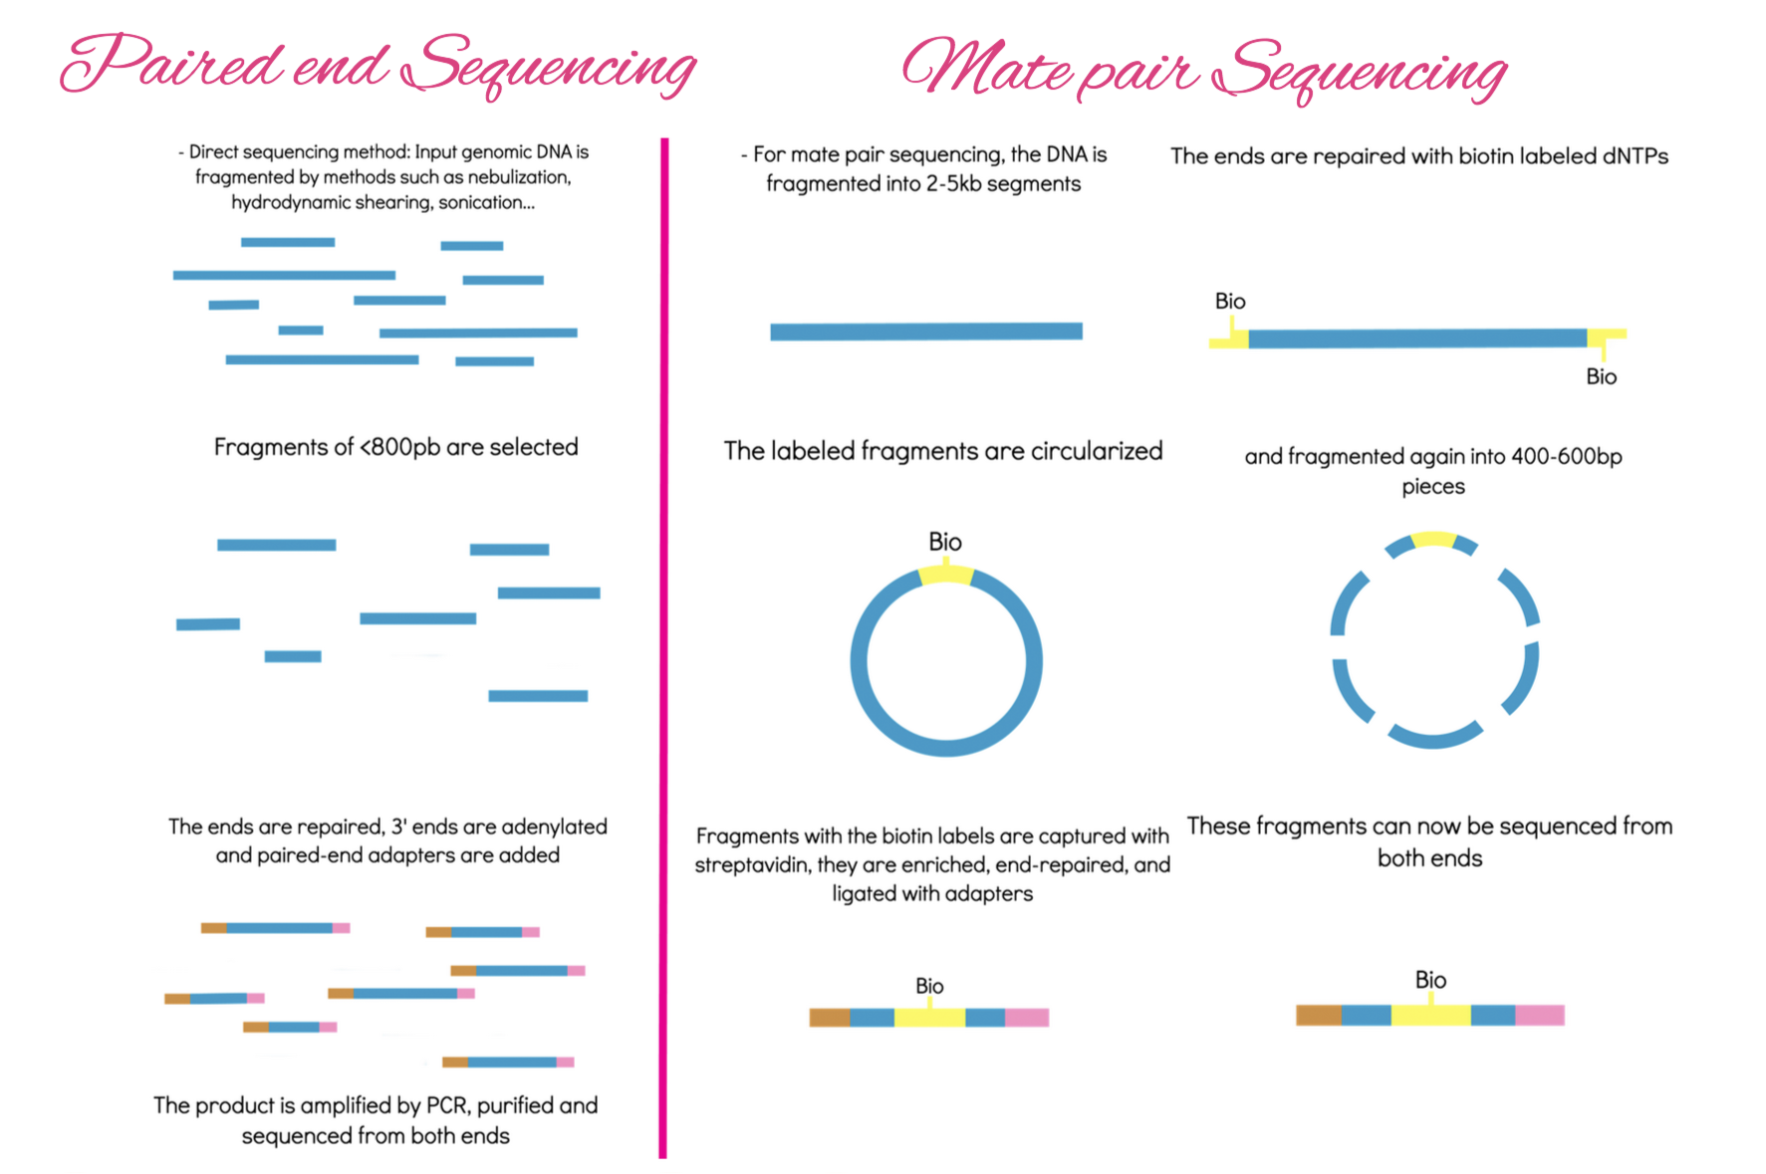
http://era7bioinformatics.com

Slide 19
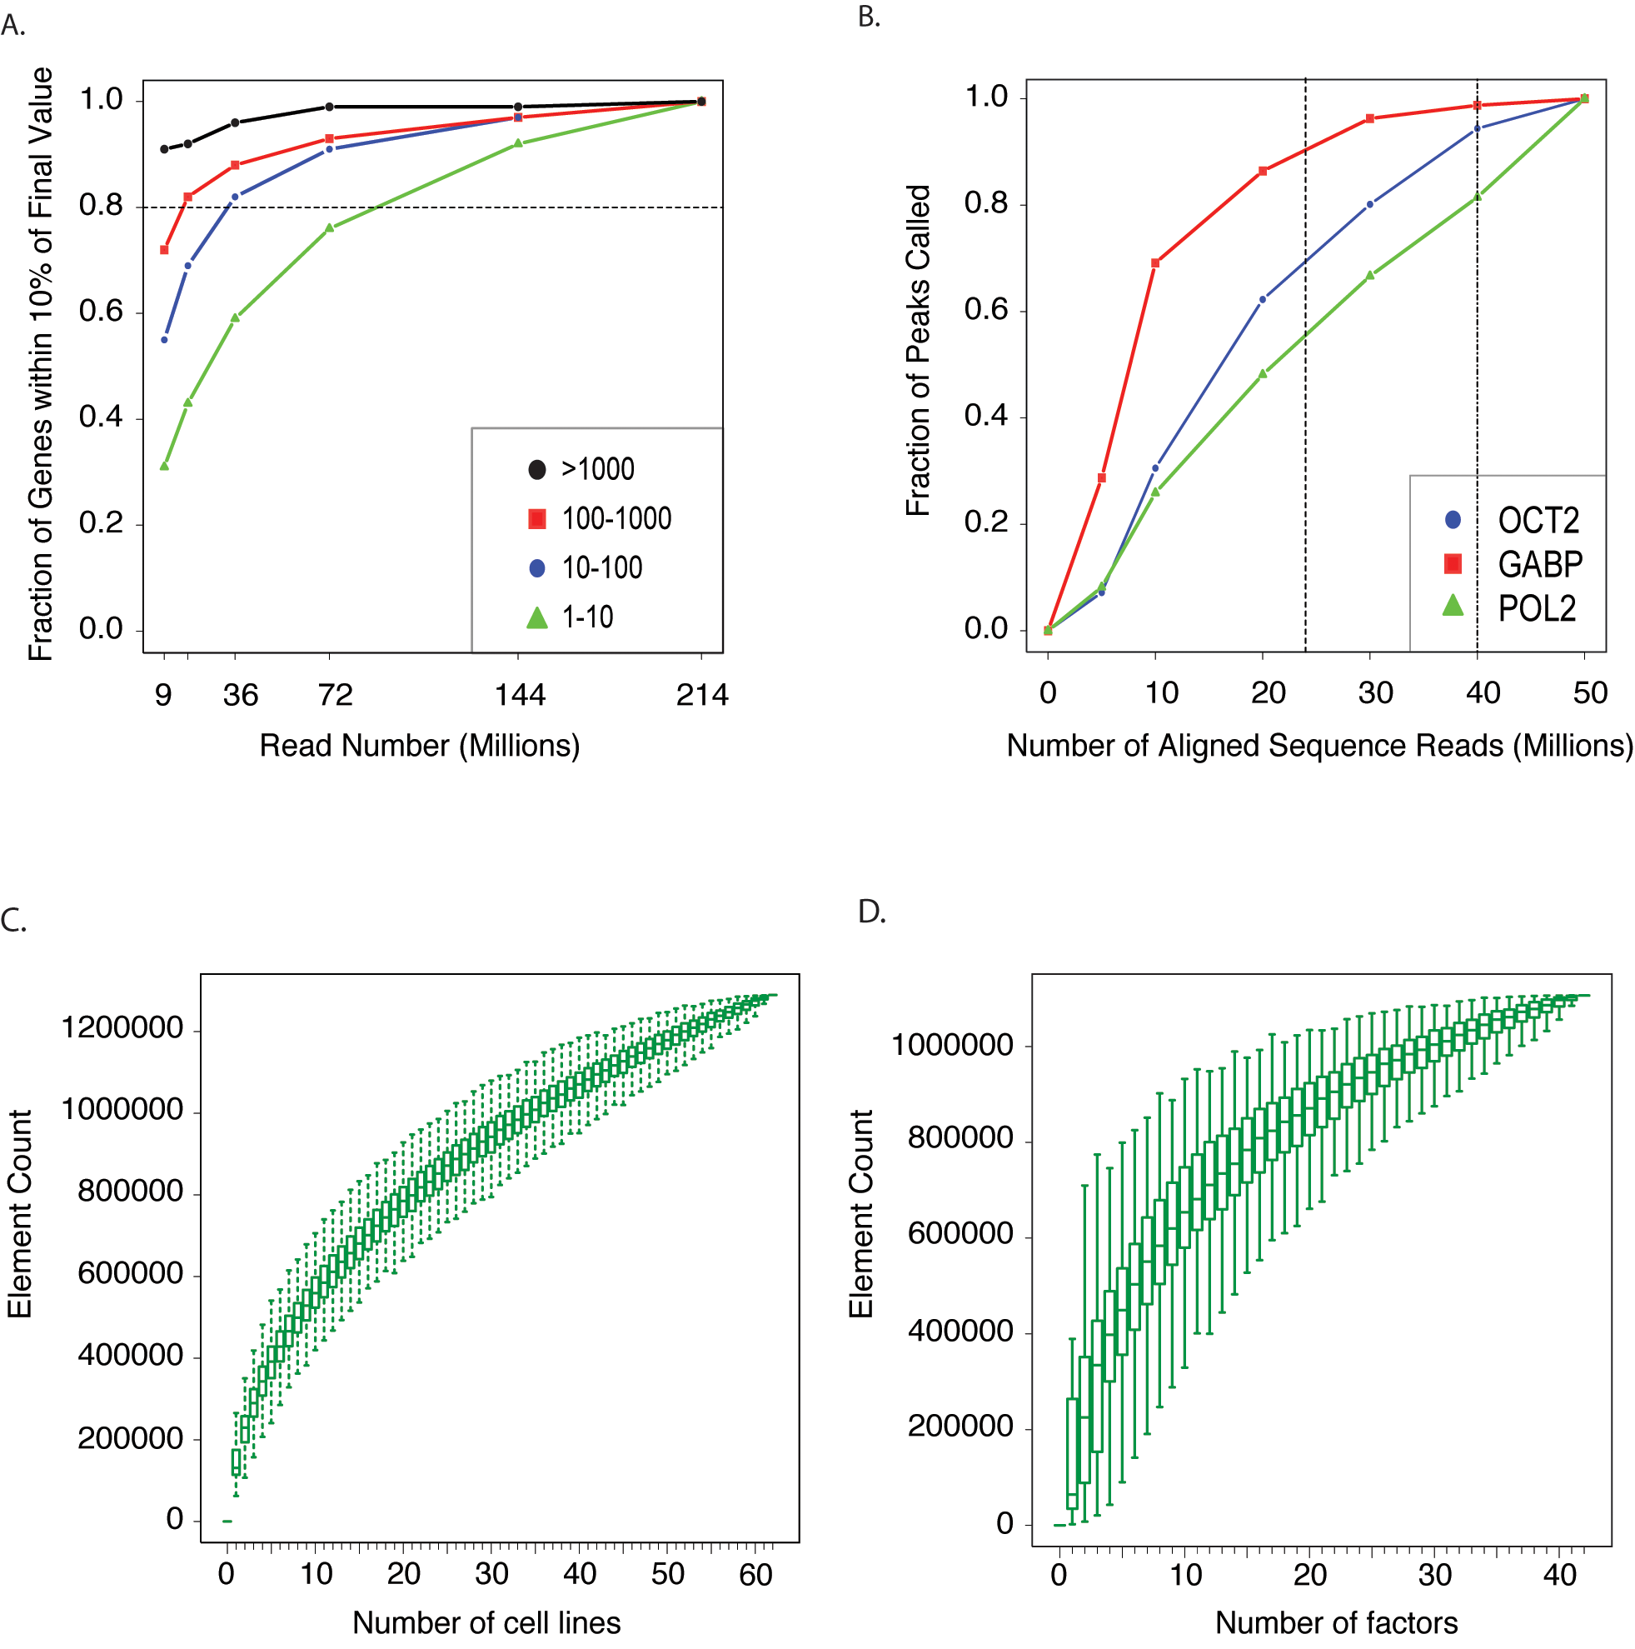
Sequencing depth
Quantification of gene expression usually requires ~30-40 million reads
To identify rare events (isoforms, somatic mutations) much more depth is required
Not easy to know in advance, some experimentation is typically required
RPKM class
A User's Guide to the Encyclopedia of DNA Elements (ENCODE) PLoS 2011

Slide 20
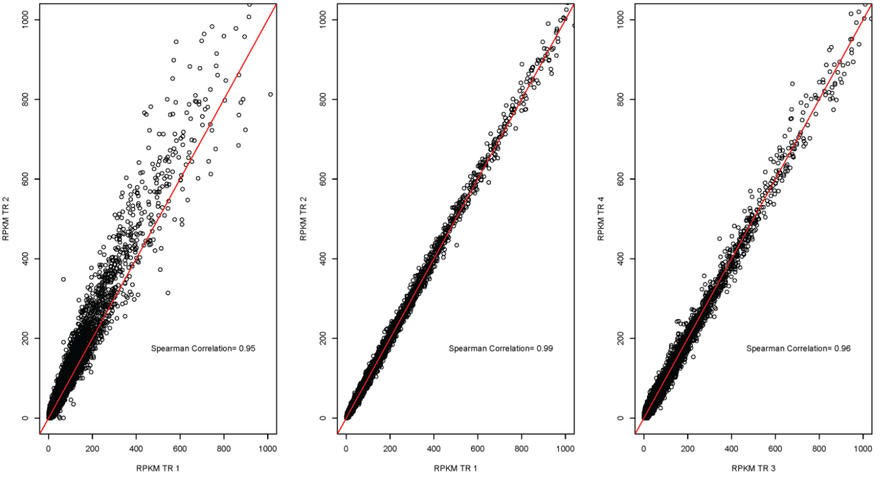
Technical replicates – generally not required
D. simulans male heads BR2
D. melanogaster female heads BR2
c167 cell line
Lauren M Mclntyre et al., BMC Genomics 2011
Notes:
<number>

Slide 21
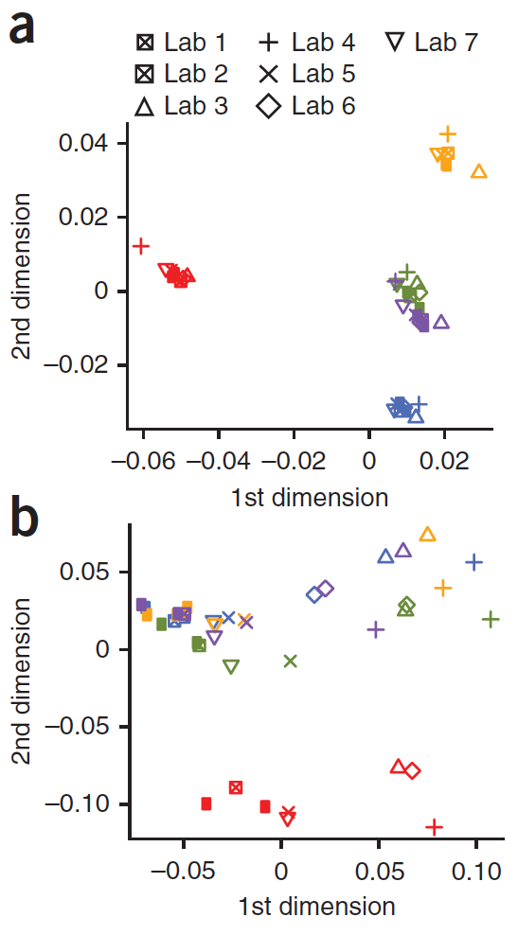
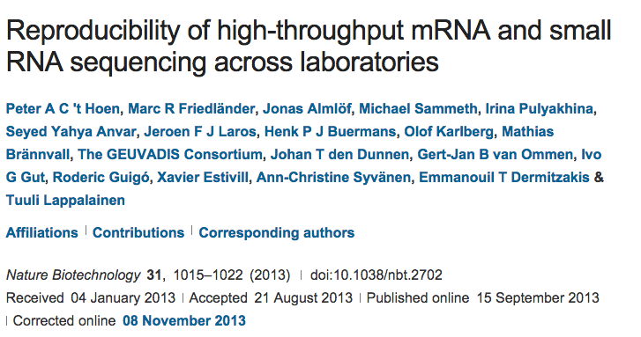
Experimental replicates – interlaboratory variation
7 labs, 48-113 samples, five shared samples, same library kit, paired-end reads of same length
Exon level :
Downstream of RNA extraction, sample preparation is quite reproducible.
Notes:
<number>

Slide 22
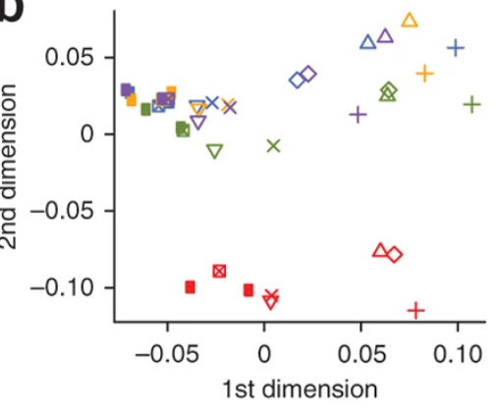
Experimental replicates – interlaboratory variation
7 labs, 48-113 samples, five shared samples, same library kit, paired-end reads of same length
Transcript level :
Downstream of RNA extraction, sample preparation is quite reproducible.
CHECK FOR BATCH EFFECT!
Notes:
<number>

Slide 23
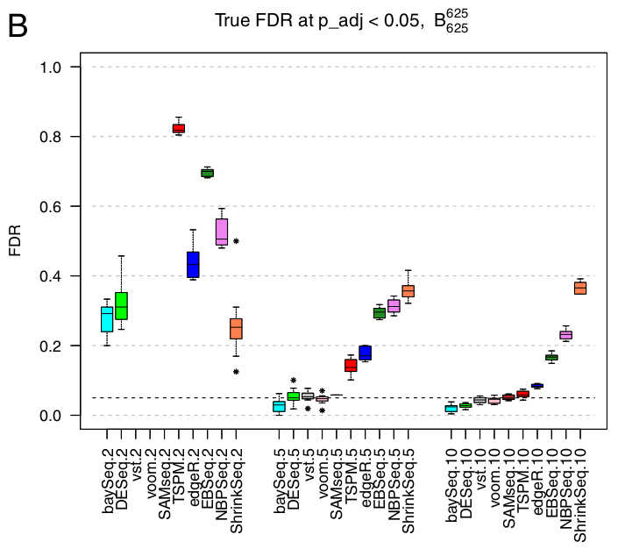
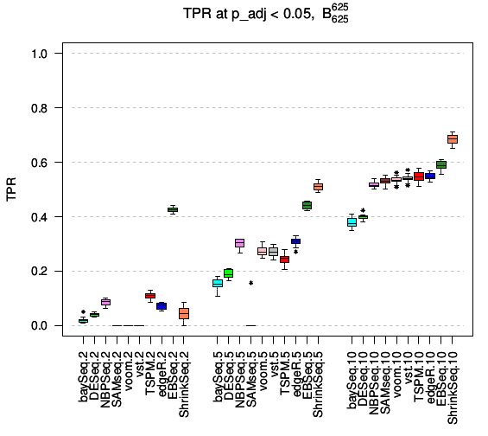
Biological replicates
2
5
10
2
5
10
Samples per condition
Soneson & Delorenzi 2013 BMC Bioinformatics
Notes:
<number>

Slide 24
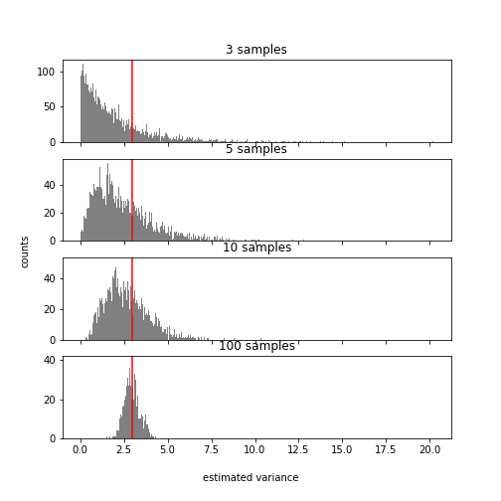
Estimating variance of a normally distributed variable
True variance = 3
What does this tell you about the ideal number of replicates for your RNA-Seq experiment?

Slide 25
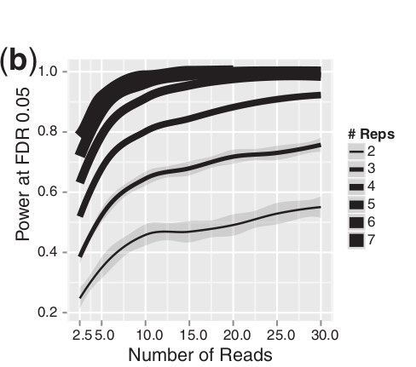
More reads or more replicates ?
Generally more replicates should be
preferred if they can be obtained.
From Liu et al. 2014. RNA-seq differential expression studies: more sequence or
more replication?

Slide 26
Experimental design resources
Local sequencing facility and/or bioinformatics unit
https://genome.ucsc.edu/ENCODE/protocols/dataStandards/ENCODE_RNAseq_Standards_V1.0.pdf
http://seqanswers.com/
https://www.biostars.org

Slide 27
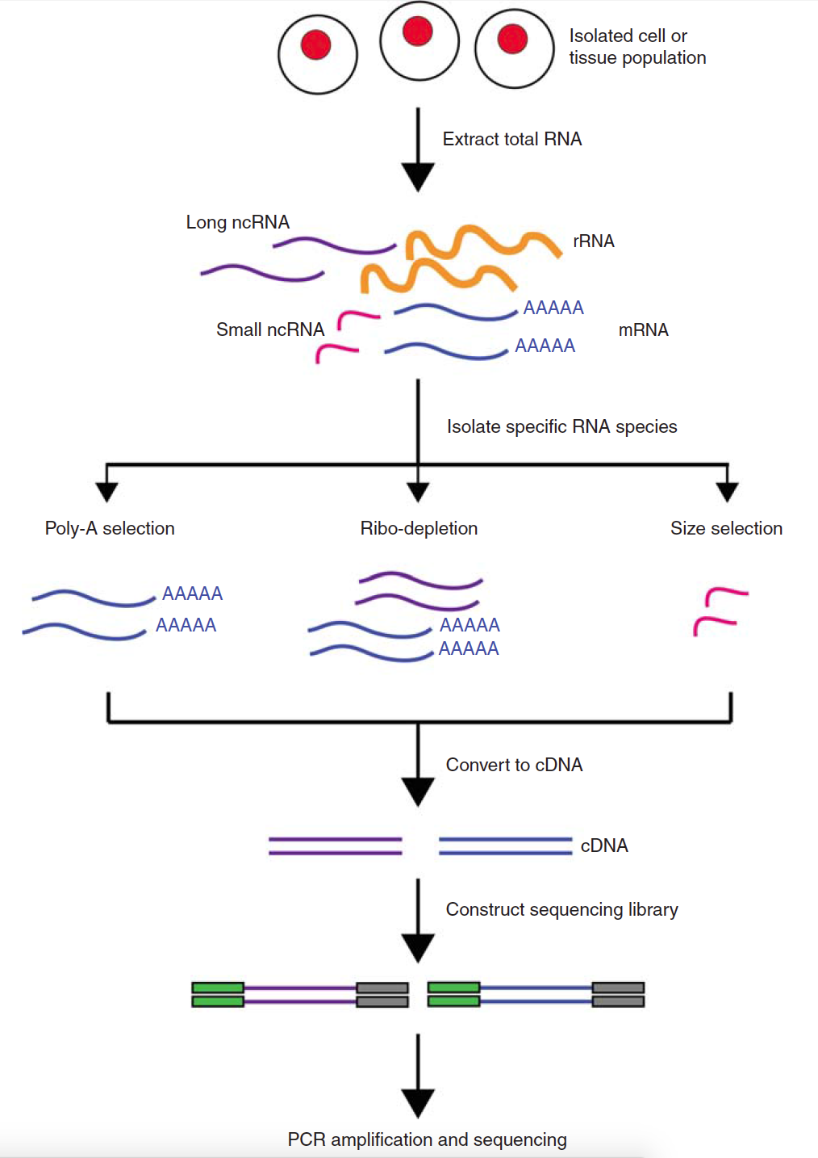
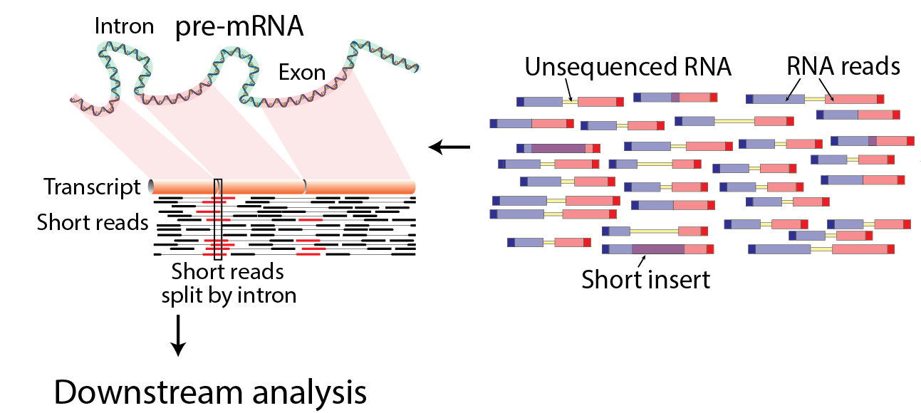
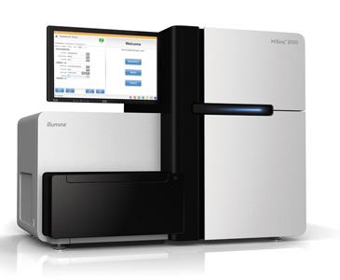
Basic RNA-Seq Protocol Overview

Slide 28
Complex protocols:
CLIP
Crosslinking with
254 nm UV light
4-thiouridine treatment
Crosslinking with
365 nm UV light
AAAA
AAAA
A)
Small RNA seq
B)
PAR-CLIP
C)
CLASH
D)
HITS-CLIP
Immuno-precipitation
Cell lysis
Immuno-precipitation
RNase treatment
Radioactive Phosphorylation
RNase treatment
RNase treatment
P
OH
Ni-NTA binding
Immuno-precipitation
P
AAAA
³²P
Gu-HCl washing
PNK treatment
AAAA
OH
Y
PNK treatment
3’ adapter ligation
Gel purification
Proteinase K treatment
P
Intermolecular
ligation
³²P
Y
³²P
Gel purification
P
OH
Proteinase K treatment
3’ adapter ligation
RNA-RNA hybrid
³²P
E)
iCLIP
3’ adapter ligation
PNK treatment
5’ adapter ligation
P
³²P
Reverse transcription
5’ adapter ligation
Ni-NTA elution
Circularization
Gel purification
Proteinase K treatment
5’ adapter ligation
Linearization
Adapter-flanked insert
PCR amplification
Mittal & Zavolan
Genome Biology 2014
cDNA synthesis
PCR amplification
Sequencing
Data Analysis
Notes:
<number>

Slide 29
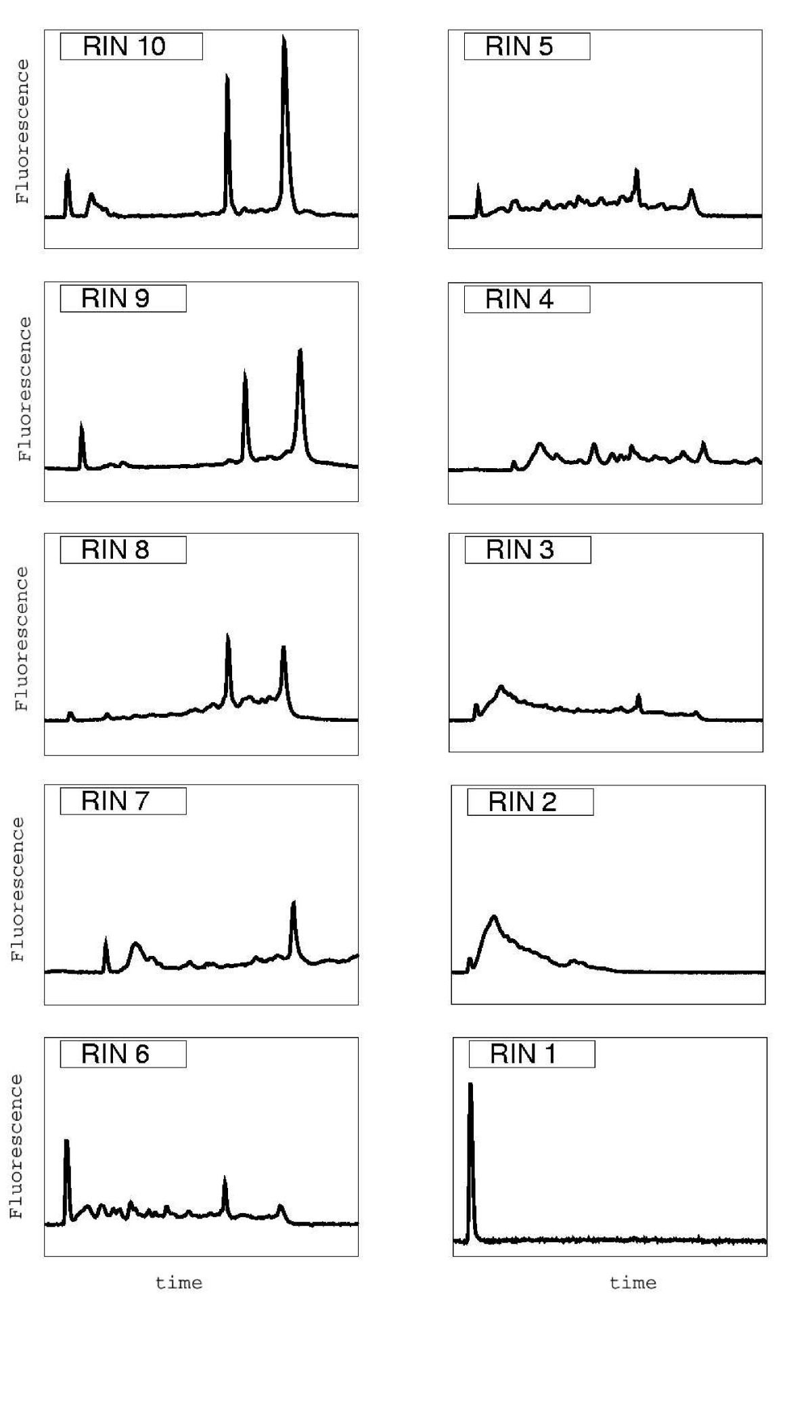
RNA Sample Preparation – RNA isolation
Critically important, a good analysis cannot make up for poor data!
RNA integrity number (RIN) estimates integrity based on the Agilent profile
Schroeder et al BMC Mol Biol 2006

Slide 30
RNA-Seq Preparation - Purification
Consider which RNA species you are trying to purify
Consider the tissue source and number of cells
PolyA selection
Commonly used and inexpensive
3` end bias when RNA is degraded
Loses almost all non-polyA transcripts
Gets rid of vast majority of ribosomal RNAs
Ribosomal RNA depletion
Less popular, ~2X more expensive
Higher proportion of rRNA compared to polyA selection
Allows identification of lncRNAs without polyA tails

Slide 31
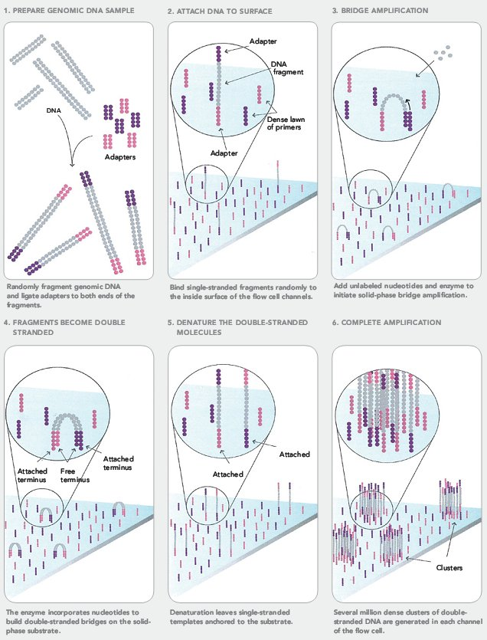
Illumina sequencing – “cluster formation”

Slide 32
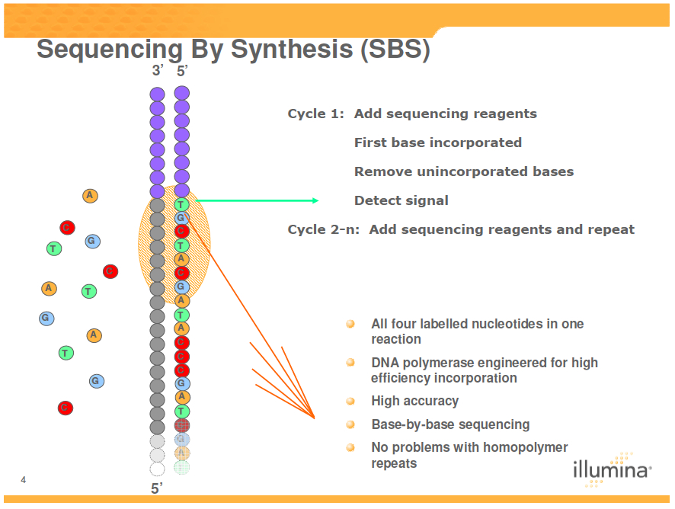
Illumina sequencing – “sequencing by synthesis”

Slide 33
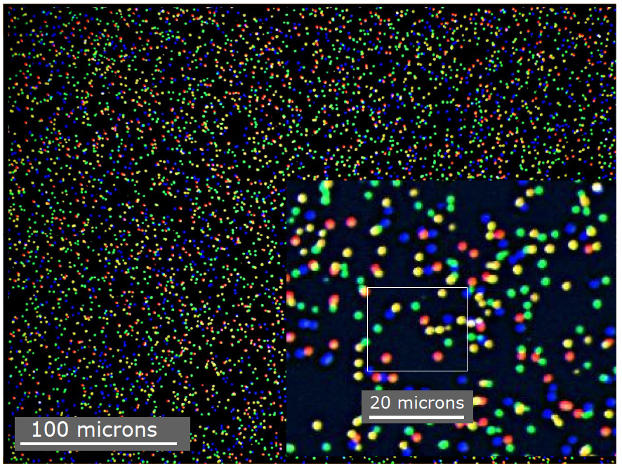
Illumina sequencing – image analysis
On the fly, instrument-associated software

Slide 34
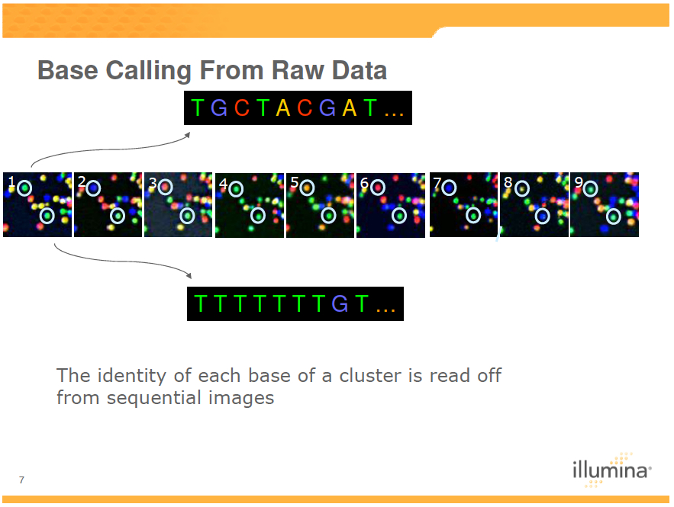
Illumina sequencing – from image to sequence

Slide 35
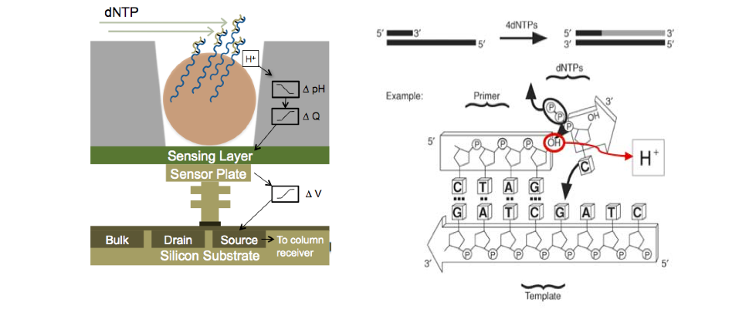
Ion torrent – reading pH changes

Slide 36
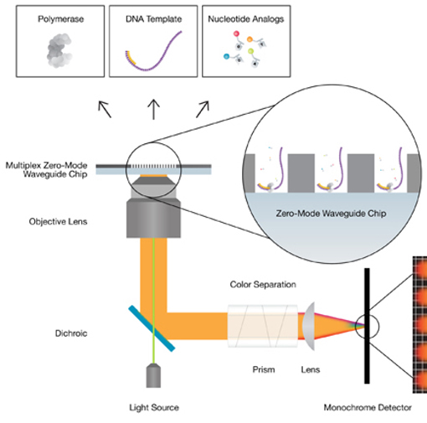
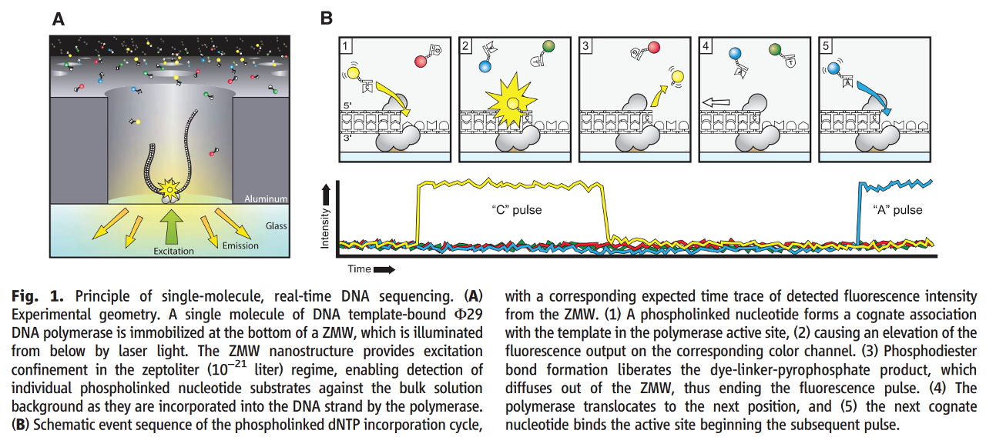
Pacific Biosciences – single molecule real time sequencing
Rhoads & Au.
Genomics Proteomics Bioinformatics 2015

Slide 37
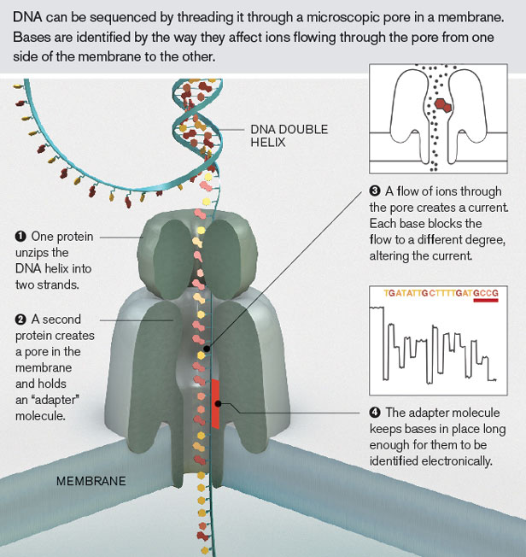
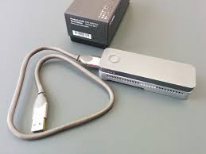
Oxford Nanopore – direct DNA/RNA sequencing

Slide 38
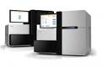
RNA-seq data analysis
Sequencing facility
Raw data
Quality Assessment
Pre-processing
raw data + quality scores
Filtering and trimming
Filtered raw data
De novo assembly
Alignment (mapping)
to reference genome
Assembled genome/transcriptome
Aligned reads
Read Counts
Differential Expression
Gene Ontology enrichment
Pathway enrichment
Isoforms detection, gene fusion
Structural variants, mutations, deletions
etc…
Post-processing

Slide 39
File formats in RNA-Seq workflow
Raw data | FastQ
Alignments | SAM, BAM, CRAM
Genome annotation | GFF
Intervals | BED
Variants | VCF, BCF
Continuous data | WIG, bedGraph
http://genome.ucsc.edu/FAQ/FAQformat.html

Slide 40
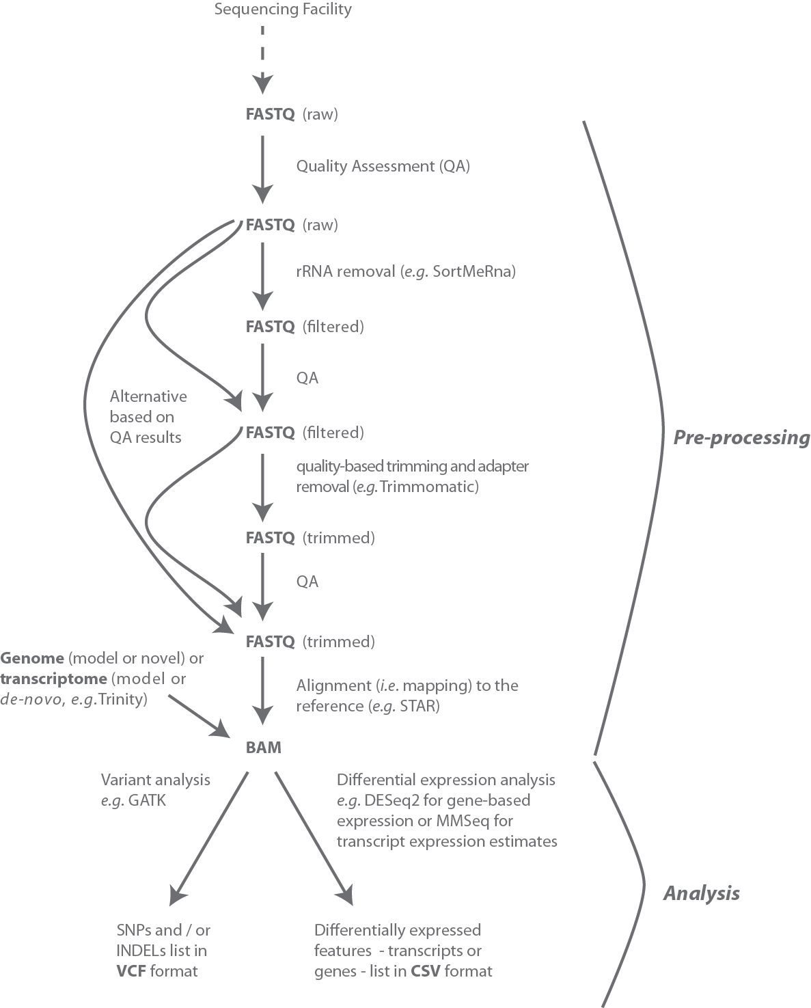
File formats in RNA-Seq workflow

Slide 41
RNA-Seq Quality Control
FASTQ files have a per base quality score (covered in detail later). There are many tools to evaluate sequencing quality and perform trimming/modification
A post-hoc method to detect low quality data:
Transcript integrity number (TIN) estimates the uniformity of coverage of a transcript by reads → degraded transcripts have poor 5` coverage
Uniformity of coverage estimated as Shannon entropy of read frequency per position, take median over transcript
Read coverage profile
5’
3’
Cap
Poly(A)
Wang et al BMC Bioinformatics 2016

Slide 42
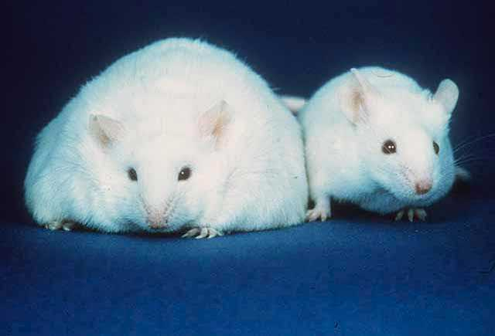
RNA-Seq for differential gene expression
Typically: which genes are expressed at higher/lower levels in the treated versus control samples?

Slide 43
Contributors: Wandrille Duchemin
Geoffrey Fucile Walid Gharib Pablo Escobar Lopez Charlotte Soneson Mihaela Zavolan

